Slide 1


Board Financial Literacy
May 13th, 2011 3:45 p.m.
Facilitated by: Mike Moyes of MCUL/CUcorp
Sponsored by
Great Lakes. Great People. Great Credit Unions. Positively Michigan!

Slide 2

Board Financial Literacy
AC&E Presentation

Slide 3
        Presented by:
        Mike Moyes
        CUcorp/MCUL
        Mike.Moyes@CUcorp.com
        March 23rd, 2011

Slide 4
Introduction
The facilitator
  Mike Moyes
  CUcorp/MCUL
Vice President of Strategic Solutions
  Strategic Planning
  Board Governance and Training
  Income and Capital Improvement
  Field of Membership Expansion
  Special Projects

Slide 5
My Background
Internal Auditor- I Robbed a Bank
Vice President-CFO of $500 Million Credit Union
President/CEO- $265 Million Credit Union
Vice President- MCUL/CUcorp

Slide 6

Agenda
Welcome!
Agenda
NCUA Regulation 701.4 (MCUL/CUNA tools)
Accounting and Finance principles
Balance Sheet
Income Statement

Slide 7
Agenda- continued
7. Key Ratios- What to watch
Spread Analysis- How does a credit union work?
Understanding and Managing Risk
10. Conclusion

Slide 8

New Regulation
701.4 of the NCUA Rules and Regulations was
amended in December 2010 to add clarity to the
duties of FCU directors.
Specifically, the NCUA added a new financial literacy requirement.

Slide 9
What’s required?
Beginning this year, every director must have a
“working familiarity with basic finance and
accounting practices”…..

Slide 10
Every Director must develop:
The ability to read and understand a FCU’s
Balance Sheet and Income Statement, along with
The ability to “ask, as appropriate, substantive
questions of management and the internal and
external auditors”

Slide 11
When is this due?
All FCU directors must receive basic financial
literacy training by this July (2011).
Every new FCU director must receive basic financial literacy within six months of his or her election or appointment to the board.

Slide 12
Accounting and Finance Principles
Every transaction that takes place at the credit union is captured by the computer system.
Each is recorded in the General Ledger.
Every transaction will have a least one Debit and one Credit recorded. Debits equal Credits.
All of these GL Accounts contribute to a major category on the Financial Statements.

Slide 13
Balance Sheet
The Balance Sheet or Statement of Financial Condition lists the Assets, Liabilities, Savings and Equity accounts of a credit union.
It’s a “snapshot in time”, showing the financial state of the credit union, on a specific date such as a month end or year end.

Slide 14
Balance Sheet
Formula:
Assets= Liabilities plus Equity

Slide 16

Assets
Assets are things of value a credit union owns.
Loans to Members
Cash
Investments
Buildings
Equipment and Furniture

Slide 17
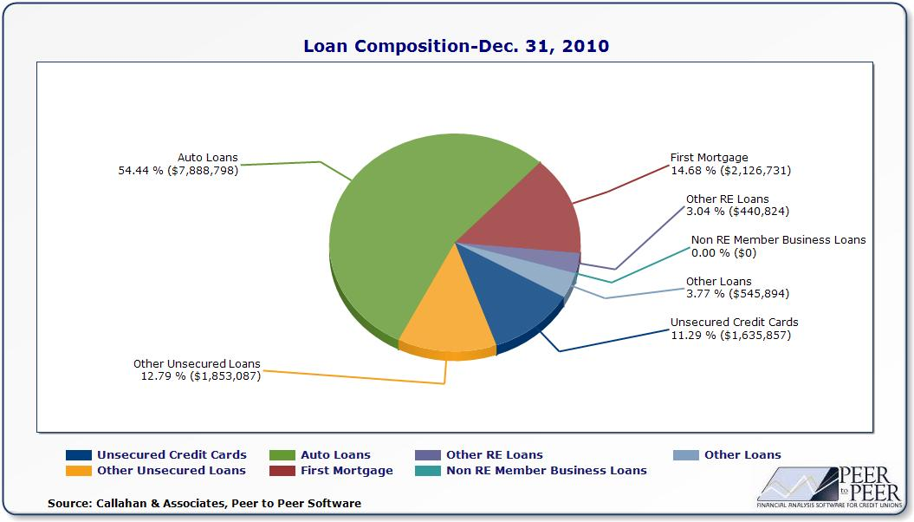

Slide 18
Assets
Loan rates are higher than Investment rates. In almost every case, it’s better to have as many quality loans as possible. What you can’t lend out you invest to get a better return than overnight funds.
Investments should be laddered to mature when the funds will most likely be needed. Usually this is in the Spring and Summer when loan demand is higher.

Slide 19
Assets
Building branches should follow careful analysis of what the new building costs and expenses will do to the Income Statement.
Computers, ATMs, Equipment, Furniture and fixtures should be depreciated over the useful life of the asset and not completely at purchase.

Slide 20

Liabilities
Invoices or Contract amounts owed to others.
Typically liabilities are:
Accounts Payable
Notes Payable
Interest Payable to Members for Deposits

Slide 21
Liabilities
Some member savings accounts pay dividends quarterly. The dividend expense is accrued as a liability over three months and then paid to members.

Slide 22

Member (Owners) Equity
Equity or Capital Reserves allow the credit union to absorb setbacks and losses without doing damage to its own long term viability.
All Member Deposit Accounts
Regular and Other Reserve Accounts
Undivided Earnings

Slide 23
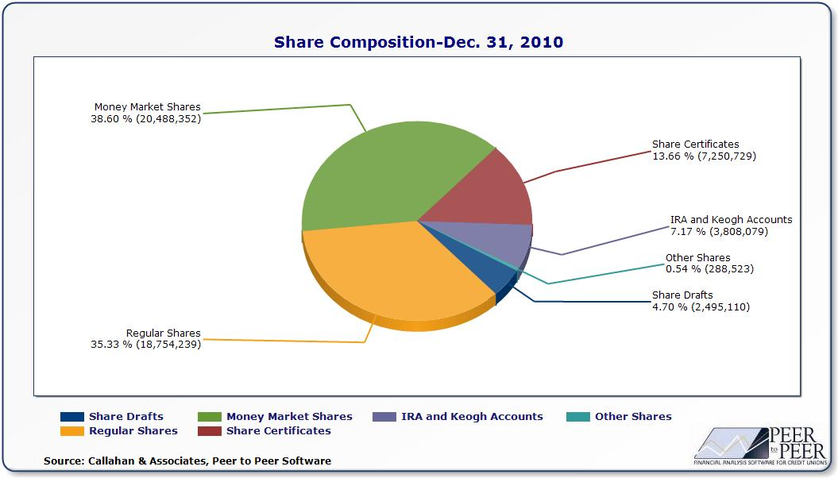

Slide 24

Income Statement
The Income Statement or Profit and Loss Statement, as it is sometimes called, contains the credit unions income and expenses over a specific time period.
It is prepared on a monthly basis and shows if the credit union is earning a net profit or income.

Slide 25
Income Statement
Formula:
Income less Expenses= Net Income

Slide 27
Income Sources
Loans Income
Investment Income
Fee and Other Income
CUSO Income
Non Operating Income
Other Income

Slide 28
Expense Sources
Usually the largest operating expense of any credit union is the amount of compensation (wages, salaries, health insurance and payroll taxes) paid to employees.
Typically, the next largest expense categories are the computer system, branch network and vendor contracts.

Slide 29
Expenses
Salary and Benefits
Office Operations
Building, Equipment and Furniture
Education
Loan Loss Provision
Travel and Conference
Marketing
Other

Slide 30
Key Financial Ratios
A Ratio is simply a mathematical relationship between two numbers.
Most Ratios and Trends are based on the financial information contained in the credit union’s financial statements.
Ratios are important to management and volunteers because they map out the financial progress of the credit union

Slide 31
Key Financial Ratios
CAMEL Ratios- CAMEL is an NCUA acronym for Capital, Asset Quality, Management, Earnings and Liquidity
Ratios are important to management and volunteers because they map out the financial progress and trends of the credit union

Slide 32
Capital- Net Worth
This Capital ratio is used to determine the financial health of a credit union. Historically, over 7% Net Worth classifies as “Well Capitalized”.
All Reserve Accounts (except for Allowance for Loan Loss)
Assets

Slide 33
CU Capital Adequacy (Net-Worth Ratio)
Notes:
Credit union capital-to-asset ratios are expected to decline to 9.6% in 2010 and 2011—the lowest ratio since 1994—as capital contributions fail to keep pace
with asset growth. Capital limitations will restrict the pace of asset growth for some credit unions. These credit unions must align their asset growth to their
earnings growth to maintain their capital-to-asset ratio. To achieve this balancing act, credit unions should focus on optimal deposit pricing.

Slide 34
Delinquency Ratio
This ratio indicates the strength of the credit unions loan underwriting practices and how well the credit union is controlling its loan payment process.
Delinquent Loans
Total Loans

Slide 35
U.S. Unemployment & Recession
Full Employment 5%
Source: U.S. Department of Labor

Slide 36
Return on Assets
Probably the most commonly used measurement for credit union performance.
Net Income for the Year
Avg. Total Assets for the Year

Slide 37
Net Income to Average Assets (ROA)
Notes:
One of the most important outcomes of the credit crisis is that credit unions will find it more difficult to generate sufficient earnings and capital contributions.
The big question is inflation. If it rises, the credit markets will respond with higher interest rates, which could present a significant risk for credit unions holding large positions in
long-term, fixed-rate mortgages.
A rising interest rate environment could then lead to falling credit union earnings as rising funding costs outpace sluggish increases in asset yields. This scenario
happened a generation ago and was a contributing factor to the demise of hundreds of savings and loans. It’s unlikely we’ll see a significant increase in inflation
in the next few years. But with interest rates at historic low levels today, there’s only one direction they can head tomorrow. So your credit union should be modeling
the income-statement and balance-sheet effects of a three to four percentage-point increase in interest rates during the next two to four years.
In the meantime, the current steep yield curve and strong deposit growth will be a silver lining for credit union earnings. For credit unions with strong loan demand, the
steep yield curve should increase net interest margins as they use low-rate, short-term deposits to fund longer-term, higher-rate loans.
Credit union earnings have passed their low point and will improve during the next two years. Lower loan-loss provisions, rising net interest margins, and
cost-containment efforts will boost earnings from 2009’s historic low of 15 bp.
Credit union average return on assets are expected to recover to 40 bp in 2010 and 60 bp in 2011 (before corporate stabilization expenses). Credit unions should
budget for NCUA assessments to consume 20 to 40 bp of assets for years to come.

Slide 38

Other Ratios
Loan to Share Ratio- shows how much of your member deposits are loaned out.
Expenses to Income Ratio- This ratio dictates whether the credit unions efficiency is improving.
New “trendy” ratios- Efficiency Ratio, Core Earnings, etc.

Slide 39
Other Financial Reports
Delinquent Loan Report.
Investment Report
Depreciation Report
Amortization Report
Charge Off Loan Report
Membership Report

Slide 40
How does the CU make money?
Spread Analysis
  +Yield on Loans
  +Yield on Investments
  Cost of Funds on Member Deposits
  = Gross Spread (Margin)

Slide 41
How does the CU make money?
Spread Analysis
  +Gross Spread
  +Fee Income
  Operating Expenses and Allowance for Loan Loss
  = ROA

Slide 42
Risk Management
One of the fundamental roles of the Board of Directors is to assess the level of risk faced by the credit union and to oversee the management of risk by the CEO and management.
We are in the “Risk” business. Every loan and investment has a degree of risk associated with it.

Slide 43
How to Mitigate Risk
Avoid the risk by installing security measures and policies to deter wrongdoers.
Reduce the risk by adopting procedures that make it difficult to invade systems.
Spread the risk by maintaining duplicate systems and records offsite.

Slide 44
How to Mitigate Risk
Transfer the risk by purchasing appropriate insurance coverage.
Assume the risk by absorbing certain types of losses as a cost of doing business.

Slide 45
Risk Management
Types of Risk include:
Credit Risk
Liquidity Risk
Interest Rate Risk
Compliance Risk
Strategic Risk
Transaction Risk
Reputation Risk

Slide 46
Credit Risk
The oldest of all risks.
It is the danger that a borrower will fail to repay the loan or interest payment.
Mitigate by implementing a best practices risk based lending system with quality collections.

Slide 47

Liquidity Risk
Is concerned with maintaining an adequate availability of funds for loan demand, share withdrawals, accounts payable expenses, and daily corporate transactions.
Mitigate with a strong ALM program, Policy guidelines, What-if scenarios and analysis.

Slide 48

Interest Rate Risk
The potential impact of interest rate movements on the credit unions net interest income and capital levels.
Interest rate risk focuses on the repricing speed of assets relative to liabilities. Mitigate with ALM Shock Analysis and NEV calculation.

Slide 49

Compliance Risk
Compliance risk involves new regulations and requirements that credit unions need to comply with. The complexity, scope and constant flow of new regulatory guidelines increase our Compliance risk.
Mitigate by having an individual assigned to be the compliance officer. Train staff and perform internal audits to ensure conformity.

Slide 50
Strategic Risk
These are the external influences that can impact the ability of the credit union to meet its goals and objectives.
These external influences can be economic, political, taxation based, natural disasters, field of membership based, or due to financial industry competition.

Slide 51
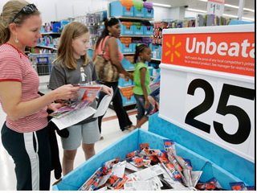
Transaction Risk
Is associated with systems the credit union uses, the processes used to distribute products and services to members, technology, and employees involved in providing services to members.
Mitigate by partnering with experienced vendors and by continually training and monitoring system performance. Get legal opinions, when needed.

Slide 52

Reputation Risk
The credit union’s reputation is an extremely important element of its character, one that needs to be protected. We thrive and survive basis of public trust. Negative publicity needs to be handled quickly and effectively.
Mitigate by managing the credit union effectively and having a P/R plan ready to implement if necessary.

Slide 53
Strategic Considerations
Profitability
  Do we invest in “profitable” members or do we invest in the future? (or both?)
Delivery Channels
  Do we invest in branches, or do we invest in technology? (or both?)
Growth
  Do we grow in numbers of relationships or in numbers of members? (or both?)
Products and Services
  Do we refine our current product array or do we move to leading edge to capture new markets? (or both?)

Slide 54
Other Strategies to review:
Product and Delivery systems.
Facilities and Branching.
Marketing.
Information Technology.
Growth- Members, Assets, Loans and Deposits.
Human Resources.

Slide 55
Thank You!

Slide 56
        Presented by:
        Mike Moyes
        CUcorp/MCUL
        mike.moyes@cucorp.com
        March 23rd, 2011

